Slide 1
Agent Training

Slide 2
Who Is Franklin Madison

Slide 3
Our Mission, Who We Are & How We Operate
Our Mission: To build customer financial security by delivering industry leading marketing services and insurance products through our brand partners.
Who We Are: The market leader in delivering industry-leading insurance products and marketing services to help banks, credit unions, and affinity partners provide financial security to families when the unexpected happens.
How We Operate: Our activities and interactions with customers, clients, and each other are guided by our core values: Well-Being, Collaboration, Mutual Respect, Visionary, Excellence, and Courage.

Slide 4

At A Glance

Slide 5







Who is Franklin Madison?
We are the service provider for the insurance consumers enrolled in with their bank, credit union, or affinity partner.
  Marketing – We offer a wide array of supplemental insurance plans from leading insurance carriers
  Billing – We facilitate the billing of customer premiums
  Claims Assistance – We help with the claims process
  Customer Service – We work diligently to deliver a positive experience by following our three core values:
We are committed to treating you with respect, listening to your needs, and always doing what’s best for you and your family.
Our goal is to provide clear, helpful and straightforward information about our products and services, empowering you to make informed decisions.
You can count on us to clearly explain what to expect from our service, ensuring you feel confident every step of the way.

Slide 6
Products
Accidental Death & Dismemberment (AD&D)
Hospital Accident Protection (HAP)
Recuperative Care
Injury Care Accident Insurance
Critical Illness

Slide 7
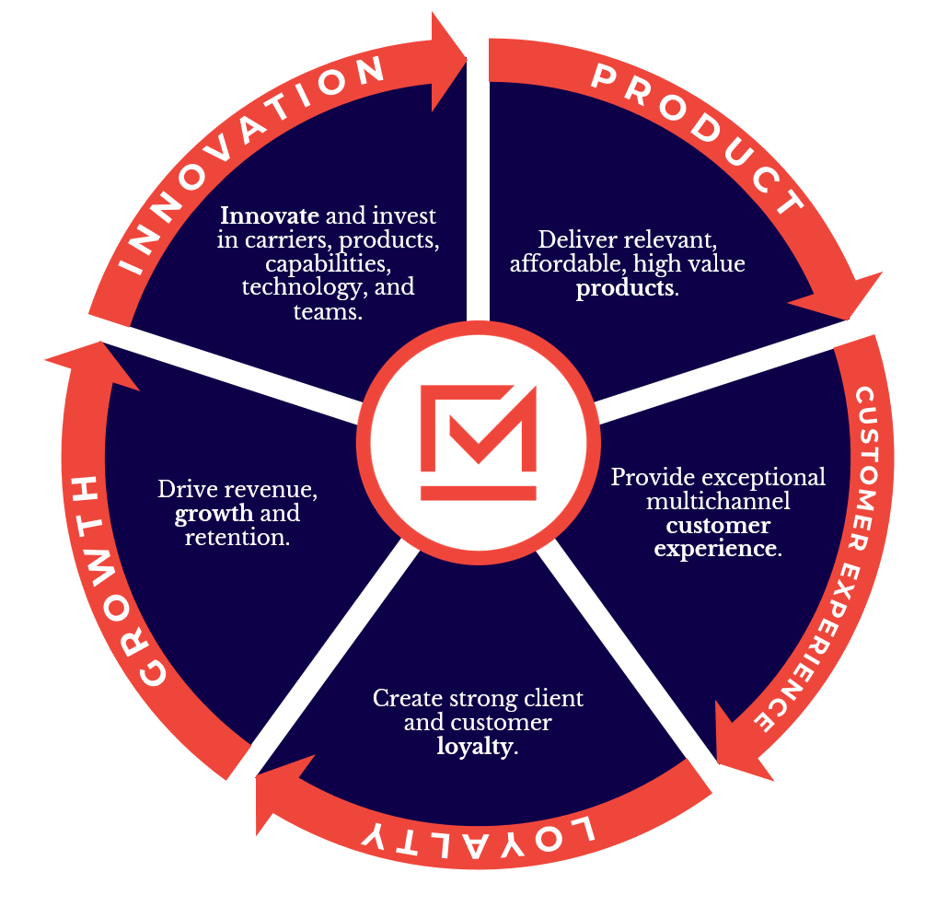
Building Momentum to Last

Slide 8
Product
Introduction

Slide 9
Terms to Know
Premiums – money customer pays for the insurance policy
Benefits – money the carrier pays to the beneficiary of the customer policy after a valid claim has been filed
Beneficiary – recipient of the insurance benefit
Policy – contract between the insurer (carrier) and insured (customer)
Activation Forms / Creative – marketing piece customer receives via mail and / or email; advertises the product
Fulfillment / Certificate of Insurance – copy of insurance policy and proof of enrollment customer receives after they enroll

Slide 10





Our Carriers
OR
OR
FEDERAL INSURANCE CO
OR

Slide 11
Product
Accidental Death & Dismemberment

Slide 12
AD&D Overview
Covers for loss of life, limb, sight, speech and hearing due to a covered accident
Offered with Minnesota Life, Chubb, and Zurich
Bank vs. credit union
  Policies for banks are issued to the Financial Services Association
  Policies are issued to the credit union
Complimentary vs. paid
  Complimentary is the insurance chosen by and paid for by the client as a service to the customer
  Paid (supplemental) is the insurance a customer pays for on their own
Individual vs. family coverage type
Age reductions – differs by carrier and product

Slide 13
AD&D Product Details
Guaranteed issue
Basic coverage $1,000 to $5,000 (client paid & complimentary to the customer)
  Assigned by the client
  Not variable by customer and not able to be “chosen” by the customer
Supplemental coverage up to $300,000 ($500,000 in rare cases)
Specific ancillary benefits vary between bank and credit union
Common carrier

Slide 14
Bank Ancillary Benefits
Common Carrier - this benefit pays twice the elected additional coverage for accidental loss of life involving a collision, crash or sinking of a common carrier while riding as a fare-paying passenger.
Education Benefit - if you suffer an accidental death, a benefit of 2% of your accidental death benefit is payable in equal monthly installments for each year for each dependent child who is enrolled as a full-time student in an institution of higher learning. Maximum benefit is $5,000 per year for up to 4 years. If at the time of the insured’s death there are no dependent children, we will pay a benefit in the amount of $1,000.
Anti-Inflation Benefit - for every two years an insured's additional coverage remains continuously in force, it will be increased by 5% until it reaches 125% of the original amount of additional coverage.
Adaptive Home and Vehicle Benefit - provides a benefit if the insured's home and/or private motor vehicle requires modifications to accommodate the insured's dismemberment or total and permanent disability resulting from a covered loss.
Waiver of Premium Benefit - if an insured becomes totally and permanently accidentally disabled prior to age 60, remains continuously disabled for at least 6 months, and continues to pay premiums during this 6-month waiting period, the insured's accidental death and dismemberment insurance will remain in force after the waiting period without payment of premium.

Slide 15
Credit Union Ancillary Benefits
Common Carrier - this benefit pays twice the elected additional coverage for accidental loss of life involving a collision, crash or sinking of a common carrier while riding as a fare-paying passenger.
Education Benefit - if you suffer an accidental death, a benefit of 2% of your accidental death benefit is payable in equal monthly installments for each year for each dependent child who is enrolled as a full-time student in an institution of higher learning. Maximum benefit is $5,000 per year for up to 4 years. If at the time of the insured’s death there are no dependent children, we will pay a $1,000 benefit.
Anti-Inflation Benefit - for every two years an insured's additional coverage remains continuously in force, it will be increased by 5% until it reaches 125% of the original amount of additional coverage.
Accident Hospital Indemnity - if you are confined to a hospital as an inpatient as a result of a covered loss for more than 7 consecutive days (starting within 30 days of the accident), then a monthly benefit will be paid. The monthly benefit will equal 1% of the additional coverage amount up to a maximum of $2,500 for up to 12 months and will be retroactive to the first day of confinement. A benefit equal to 1/30th of the monthly benefit will be paid for each day of a period of less than 1 month.
Dependent Child Care - if you die from a covered accident and are survived by your spouse and one or more dependent children, we will pay a child care benefit for each eligible dependent child (under age 13 at the time of your accidental death) who is enrolled in a licensed day care center. Benefit equal to 2% of the additional coverage amount or $2,000 (whichever is less) each year for up to two years. The maximum amount payable under this benefit is $50,000.

Slide 16
AD&D Exclusions
This is an accident product – so sickness and infection are not covered
Act of war
Breaking the law
  Taking medication other than how directed
  Intoxication
  An accident that occurs while committing a crime
Risky business – piloting a private aircraft, drag racing
“Hold my beer” – watch this!
Other various exclusions unique to the individual carrier’s policies

Slide 17
Policy Issuance
Bank issued to the Financial Services Association
  Most states do not classify a bank as a group to which an insurance policy can be issued
  Banks refer to their customers as “customers”
Credit union policy is issued directly to the individual credit union
  That means credit unions get to select additional benefits, which may include:
    Seat belt benefit
    Education benefit
    Disappearance and exposure benefit
    Child care benefit
  Credit unions refer to their customers as “members”

Slide 18
AD&D Knowledge Check
Who are our AD&D carrier partners?
What is the difference between “complimentary” and “paid”?
True or False: Banks are considered groups and get their own unique policies with their own chosen benefits.
Name one benefit, other than the death benefit, covered by AD&D.

Slide 19
Product
Hospital Accident Protection

Slide 20
Hospital Accident Protection (HAP)
Provides cash benefits to the insured in the event of hospitalization due to a covered accident
A benefit is paid for each day the insured is in the hospital
  ER benefit is paid when the customer goes to the ER for a covered accident
  Inpatient benefit is paid for each 24-hour period the customer is an inpatient for a covered accident
  Intensive care benefit is paid for each 24-hour period the customer is in the ICU for a covered accident
Available with Chubb and Zurich
Unlike AD&D, credit unions do not have their own policies and do not pick their own benefits

Slide 21
HAP
Program Description
Provides cash benefits to the insured in the event of hospitalization due to a covered accident
Pays a $900 daily hospital benefit
Pays a $1,800 daily intensive care benefit
Pays a $450 emergency room benefit
Family coverage available
Reduce by 50% at age 65 and 25% at age 75 (except in MN for Chubb)
Available to U.S. citizens ages 18 and older
Marketing Considerations
60-day, 100% money back guarantee
10% inflation benefit
State Availability
Available in 46 states, plus DC
Note that there can be variability based on approved product for specific states
(TBD for Zurich)
Monthly Pricing
Individual: $17.65 per month
Family: $29.95 per month

Slide 22
HAP Exclusions
This is an accident product – so sickness and infection are not covered
Act of war
Breaking the law
  Taking medication other than how directed
  Intoxication
  An accident that occurs while committing a crime
Self-inflicted injury, including suicide
Risky business – piloting a private aircraft, drag racing
“Hold my beer” – watch this!
Other various exclusions unique to the individual carrier’s policies

Slide 23
HAP Knowledge Check
Which carriers offer the HAP product?
What are the two major benefits of HAP?
A double benefit is paid under what circumstances?
What is the daily ER benefit for HAP?

Slide 24
Product
Recuperative Care

Slide 25
Recuperative Care Plans
Provides cash benefits to the insured in the event of hospitalization due to a covered accident or sickness
Available with Zurich, Minnesota Life, and Chubb
  Zurich is referred to as “Daily Hospital Confinement Injury and Illness”
Benefit structures and amounts differ by carrier
Recuperative care policies DO NOT exclude pre-existing conditions

Slide 26
Recuperative Care
Program Description
Provides cash benefits to the insured upon release from the hospital, in the event the insured is hospitalized due to a covered accident or sickness
Pays a recuperation benefit of $400 for each day of hospital confinement for a covered accident (varies for NC & FL)
Pays a recuperative benefit of $200 for each day of hospital confinement for a covered sickness (varies for NC & FL)
Coverage available for spouse and dependent children
Reduce by 50% at age 65 and 25% at age 75
No termination age
Marketing Considerations
60-day free trial period
30-day free trial period for Chubb
State Availability
Available in 37 states, plus DC for Minnesota Life
(TBD for Zurich)
Monthly Pricing
Individual: $24.00 per month
Family: $36.00 per month

Slide 27
Minnesota Life and Zurich Exclusions
No benefit shall be paid for Loss or Injury that is caused by, results from or contributed to by:
  self-inflicted injury or self-destruction, whether sane or insane;
  suicide or attempted suicide, whether sane or insane;
  your participation in or your attempt to commit a crime, assault or felony;
  * bodily or mental infirmity, illness or disease;
  the use of alcohol, drugs, medications, poisons, gases, fumes or other substances taken, absorbed, inhaled, ingested or injected, unless taken upon the advice of a licensed physician in the verifiable prescribed manner and dosage;
  motor vehicle collision or accident where you are the operator of the motor vehicle and your blood alcohol level meets or exceeds the level at which intoxication is defined in the state where the collision or accident occurred, regardless of the outcome of any legal proceedings connected thereto;
  * infection, other than infection occurring simultaneously with, and as a direct result of, the accidental injury;
  * medical or surgical treatment or diagnostic procedures or any resulting complications;
  travel in or descent from any aircraft, except as a fare-paying passenger on a regularly scheduled commercial flight on a licensed passenger aircraft carrier;
  war or any act of war, whether declared or undeclared;
  riding in or driving any type of motor vehicle as part of a speed contest or scheduled race, including testing such vehicle on a track, speedway or proving ground.
  repetitive stress syndromes including but not limited to rotator cuff syndrome, bursitis, tendonitis, carpal tunnel syndrome, ulnar nerve syndrome, stress fractures, neuropathy, epicondylitis or neuritis.
  * Exclusions 4, 7, and 8 do not apply to the Sickness benefit

Slide 28
Chubb Exclusions
Cosmetic Surgery - This insurance does not apply to cosmetic surgery or care or treatment solely for cosmetic purposes or complications therefrom. This exclusion does not apply to cosmetic surgery [resulting from an Accident if initial treatment of the Covered Person is begun within twelve (12) months of the date of the Accident or to treat congenital defects in covered newborns.
Illegal Acts - This insurance does not apply to any Accident or Sickness caused by or resulting from, directly or indirectly, the Covered Person’s commission or attempted commission of a felony or being engaged in an illegal occupation.
Incarceration - This insurance does not apply to any Accident or Sickness caused by or resulting from, directly or indirectly any occurrence while the Covered Person is incarcerated.
Infertility and Sex Changes - This insurance does not apply to sex changes or the reversal of tubal ligation and vasectomies, artificial insemination, in vitro fertilization, and test tube fertilization, including any related testing, medications, or Physician’s services, unless required by law.
Alcoholism and Drug or Substance Abuse - This insurance does not apply to alcoholism or drug or substance abuse. In addition, the insurance does not apply to any confinement in a detoxification facility or drug or alcohol rehabilitation facility that is not also a Hospital or part of a Hospital.
Intoxication Exclusion Vehicular - This insurance does not apply to any Accident caused by or resulting from, directly or indirectly, the Covered Person being intoxicated, while operating a motorized vehicle at the time of an Accident. Intoxication is defined by the laws of the jurisdiction where such Accident occurs.
Narcotic Exclusion - This insurance does not apply to any Accident or Sickness caused by or resulting from, directly or indirectly, the Covered Person being under the influence of any narcotic or other controlled substance at the time of the loss. This exclusion does not apply if any narcotic or other controlled substance is taken and used as prescribed by a Physician.
Pregnancy - This insurance does not apply to normal pregnancy. Complications of Pregnancy are covered as any other Sickness.
Pregnancy of a Dependent Child - This insurance does not apply to pregnancy of a Dependent Child, unless required by law.
Rest care or custodial care and treatment - This insurance does not apply to any rest care or custodial care or treatment for any Accident or Sickness.
Race or Speed Contest - This insurance does not apply to any Accident caused by or resulting from, directly or indirectly, the Covered Person being engaged in or participating in a motorized vehicular race or speed contest.
Service in the Armed Forces - This insurance does not apply to any Accident or Sickness caused by or resulting from, directly or indirectly, the Covered Person participating in military action while in active military service with the armed forces of any country or established international authority.
Suicide or Intentional Injury - This insurance does not apply to, and no benefits are payable related to the Covered Person’s suicide, attempted suicide or intentionally self-inflicted injury.
Voluntary Abortion - This insurance does not apply to voluntary abortion, except with respect to the Insured Person or his or her covered Spouse or Domestic Partner where such person’s life would be endangered if the fetus were carried to term.
War - This insurance does not apply to any Accident or Sickness caused by or resulting from, directly or indirectly, war, undeclared war, civil war, participation in an insurrection, rebellion, revolution, warlike acts by a military force or personnel, any action taken in hindering or defending against any of these or any consequences of any of these acts regardless of any other direct or indirect cause or event, whether covered or not, contributing in any sequence to the loss.
Workers Compensation - This insurance does not cover Accident or Sickness arising out of and in the course of any occupation for compensation, wage or profit or which are payable under Occupational Disease Law, Workers Compensation or similar law, whether or not application for such benefits have been made.

Slide 29
Recuperative Care Knowledge Check
Who are our recuperative care carrier partners?
Which carrier has a 30-day free trial period?
What are the two major benefit differences between HAP and recuperative care?
Which carrier’s recuperative care product is referred to as “Daily Hospital Confinement Injury and Illness”?

Slide 30
Product
Injury Care Accident Insurance

Slide 31
Injury Care Accident Insurance
Provides cash benefits directly to the insured due to a covered injury
Coverage has one plan that can pay cash benefits in four ways:
  Injury Lump Sum
  Immediate Care
  Ongoing Care
  Recovery Care
Available with Securian Life Insurance Company

Slide 32
Injury Care Accident Insurance
Program Description
Provides cash benefits directly to the insured due to a covered injury in four ways:
  Injury Lump Sum – payable per injury up to $10,000 for fractures, burns, broken teeth, eye injuries, and more
  Immediate Care – payable up to $1,200 for ER and doctor visits, X-rays, hospitalization, and more
  Ongoing Care – payable up to $5,000 for surgery, skin grafts, prescriptions, and more.
  Recovery Care – payable up to $1,000 for inpatient and outpatient therapy.
Family coverage available
No benefit reduction or termination age
Available to U.S. residents ages 18 and older
Marketing Considerations
30-day, free look with no obligation
State Availability
Limited since new product
Note there can be variability based on approved product for specific states
Monthly Pricing
Individual: $20.00 per month
Family: $49.50 per month

Slide 33
Injury Care Accident Insurance Exclusions
This is an accident product – so sickness and infection are not covered
Act of war
Breaking the law
  Taking medication other than how directed
  Intoxication
  An accident that occurs while committing a crime
Self-inflicted injury
Risky business – piloting a private aircraft, drag racing
“Hold my beer” – watch this!
Other various exclusions unique to the individual carrier’s policies

Slide 34
Injury Care Accident Insurance Knowledge Check
Which carriers offer the Injury Care Accident Insurance product?
What are the four cash benefits Injury Care Accident Insurance?
At what percentage are family members covered?
Is there an age reduction?

Slide 35
Product
Critical Illness and Injury

Slide 36
Critical Illness and Injury Insurance
Provides cash benefits for critical illness and injury treatment costs
Coverage has one plan that pays cash benefits directly to the insured when diagnosed with the following five critical conditions:
  Coma
  Heart attack
  Invasive cancer
  Paralysis
  Stroke
Available with Securian Life Insurance Company

Slide 37
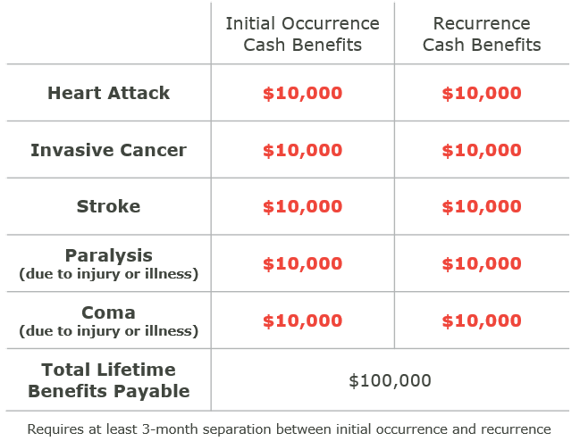
Critical Illness and Injury Insurance
Program Description
Provides cash benefits for critical illness and injury treatment costs as follows:
No family coverage available
Ages 18 to 64 are eligible
Coverage terminates at age 90
Coverage reduces by 50% at age 65
Coverage is not payable for pre-existing conditions during the first six months
Marketing Considerations
30-day, free look with no obligation
State Availability
Available in 33 states
Note there can be variability based on approved product for specific states
Monthly Pricing
Based on age at enrollment

Slide 38
Critical Illness and Injury Insurance Exclusions
Suicide or attempted suicide
Act of war
Breaking the law
  Taking medication other than how directed
  Intoxication
  Commission of a felony in which the insured was convicted in a court of competent jurisdiction
Self-inflicted injury
Insured’s use of alcohol
Other various exclusions unique to the individual carrier’s policies

Slide 39
Critical Illness and Injury Knowledge Check
Which carrier offer the Critical Illness and Injury Insurance product?
What are the five cash benefits?
At what percentage are family members covered?
Is there an age reduction?
Is there a termination age?

Slide 40
Product
Review

Slide 41
A Few Additional Items
Not all products are available in every state
  One reason the marketing code is important
Never quote a rate without checking to make sure you are looking at the marketing code in Artemis or the rate provided by the caller on the Activation Form – rates vary between states, carriers, and products
Never say “free”!
Never say a claim will be paid
  If a caller asks, let them know that it’s up to the carrier to decide if a claim will be paid

Slide 42
Review
Which carriers offer AD&D?
Which carriers offer HAP?
Which carriers offer Recuperative Care?
What is the difference between a “complimentary” and a “paid” AD&D insured?
Name an exclusion for AD&D.
What are the three HAP benefits?
What are the four cash benefits for Injury Care Accident Insurance?
What is the name of the product offered by Zurich?
Which product has a termination age?
What are the five cash benefits for Critical Illness and Injury Insurance?

Slide 43
Product
Fullfillment

Slide 44
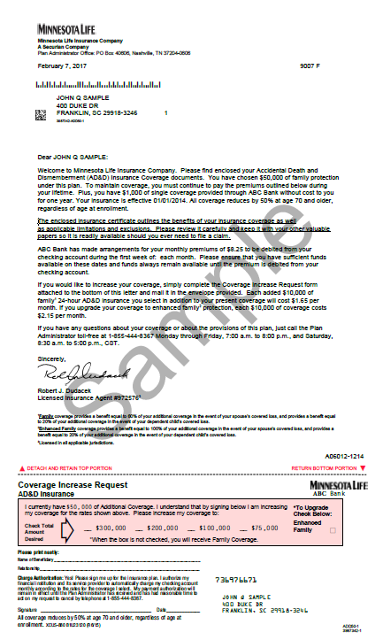
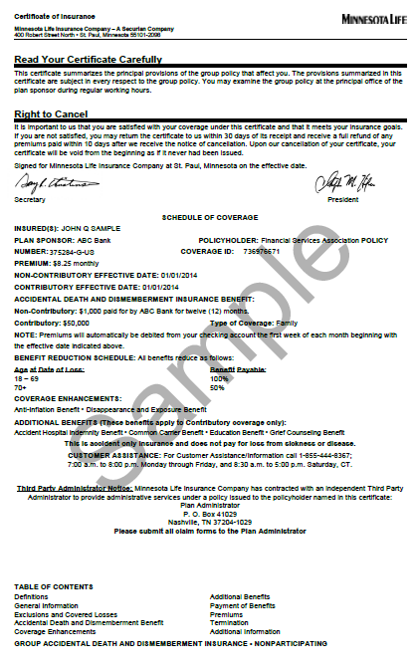
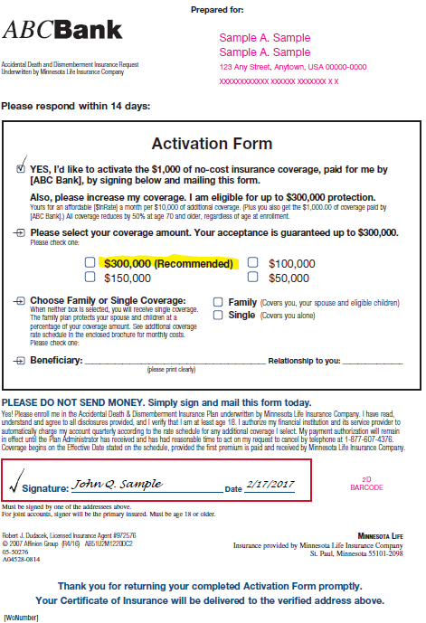
Fulfillment Review
Welcome Letter
Overview of Coverage
Signed Proof of Enrollment*
Each customer is mailed a complete fulfillment kit (Certificate of Insurance)
Key elements include the overview of coverage and signed proof of enrollment
The fulfillment kits are mailed first class to each customer within 3-5 days of enrollment
* Proof of Enrollment included for new enrollments only

Slide 45
Marketing Code

Slide 46
What is the Marketing Code?
Identifies variables unique to each marketing piece, such as financial institution, carrier, and cost to the customer
The marketing code is 6 characters and starts with a G or H
  This code is located toward the upper right hand corner of the Activation Form
You will ask the caller for this code at the beginning of the call and enter the code in Artemis

Slide 47
Marketing Code Location Exercise
AD&D
HAP
Recuperative Care

Slide 48
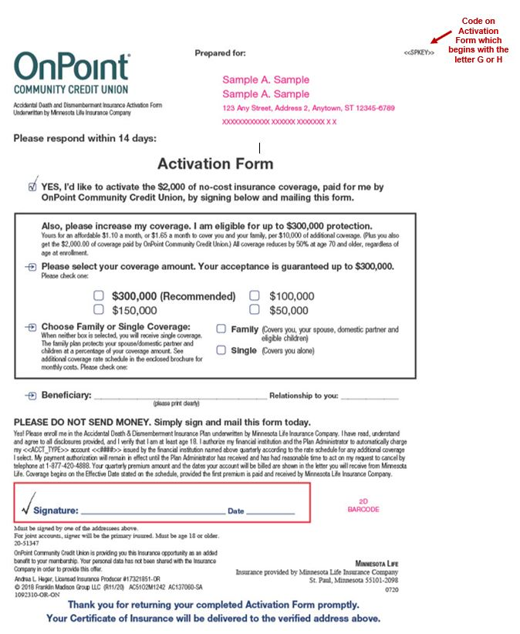

Slide 49
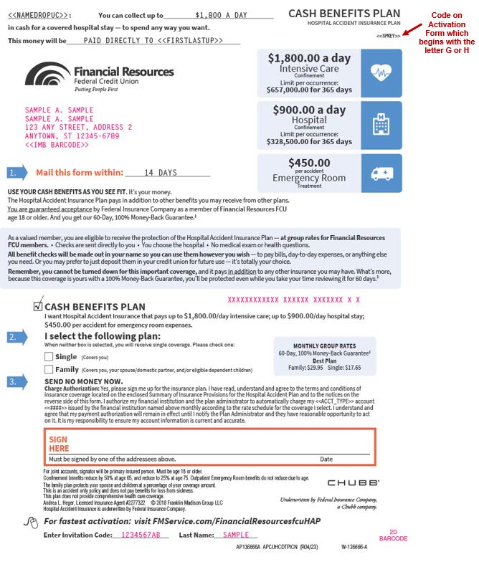

Slide 50
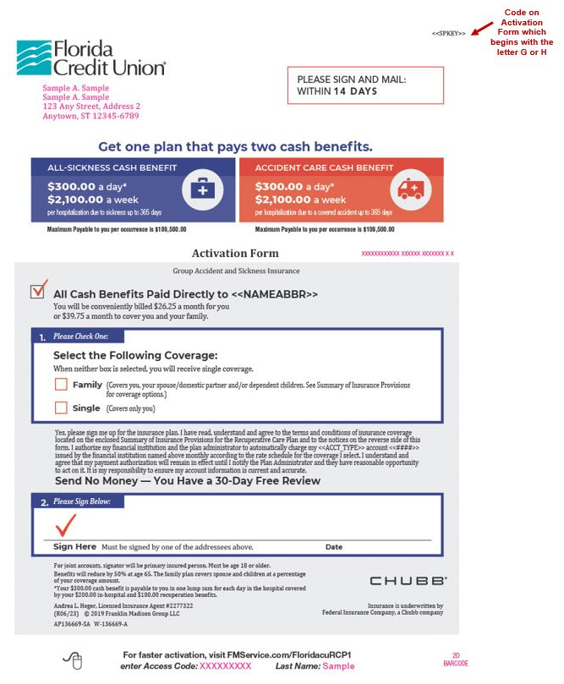

Slide 51
Marketing Code Knowledge Check
Where is the marketing code located on the Activation Form?
Which letter does the marketing code start with?
How many characters is the marketing code?
What questions would you ask to help the caller find the marketing code?

Slide 52
Knowledge Base

Slide 53
How to Navigate the Knowledge Base
Let’s review how to navigate the knowledge base

Slide 54
Using the Knowledge Base
Let’s find the following information in the knowledge base:
  AD&D Minnesota Life information
  Cancellation rebuttal
  Billing question
  Caller wants to be removed from the mailing list
  What constitutes family coverage for Chubb HAP
  How much will AD&D cost per quarter
  Additional benefits

Slide 55
UDAAP Policy

Slide 56
Unfair, Deceptive or Abusive Acts or Practices Policy
An act or practice is deemed “unfair” when:
  Likely to cause monetary harm to consumers;
  The injury is not reasonably avoidable by consumers (because, for example, the consumer does not have access to important information); and
  The injury is not outweighed by countervailing benefits to consumers or to competition
An act or practice is deemed “deceptive” when:
  It misleads the consumer;
  The consumer’s interpretation of the representation, omission, act, or practice is reasonable under the circumstances; and
  The misleading representation, omission, act, or practice is material
Notes:
All employees are required to comply

Slide 57
Unfair, Deceptive or Abusive Acts or Practices Policy
An act or practice generally is deemed “abusive” if it:
  Materially interferes with the ability of a consumer to understand a term or condition of a consumer financial product or service; or
  Takes unreasonable advantage of:
    A lack of understanding on the part of the consumer of the material risks, costs, or conditions of the product or service;
    The inability of the consumer to protect his or her interests in selecting or using a consumer financial product or service; or
    The reasonable reliance by the consumer on a covered person to act in the interests of the consumer
The contact center will conduct regular training and perform regular monitoring of contact center calls to prevent any unfair, deceptive, or abusive acts or practices
When a consumer chooses to retain a product, the call center representatives will clearly and conspicuously reaffirm the consumer’s decision to remain enrolled in the product
Notes:
All employees are required to comply

Slide 58
Elder Abuse Policy

Slide 59
Elder Abuse Policy
Verbal / Physical Abuse
  Any contact center employee who hears verbal threats or hears physical abuse must immediately contact a team lead who will contact the police or fire department in the city / town for the insured on the address on file for the insured
  Notification of any abuse incident shall immediately be reported to the Franklin Madison’s compliance manager or legal department
Other Abuse
  Any contact center employee who suspects other abuse of an elder or other individual which is not verbal or physical must immediately report the suspected abuse to a team lead who will document the call and contact Franklin Madison’s legal department
    Examples include financial exploitation or multiple attempts where an unauthorized person is trying to obtain information
Notes:
All employees are required to comply

